Slide 1
Final Project
(100 points)

Slide 2
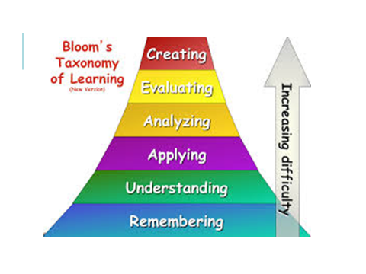

Slide 3
Final Project
(100 points)
Due December 11
Choose a gender issue/problem that we’ve not covered
  Identify your topic
  Create 3 – 5 specific gender related questions that you want to answer
Do your research
  Read at least 3 empirical sources/articles on your topic
  Write a brief summary of each study and synthesis paragraph
Create a Research Poster using PowerPoint Template
  Use PowerPoint Template to create your research poster
  Post a 3-5 minute video explaining poster (record through zoom or audio)
  Review and comment on other posters

Slide 4

What is an “empirical source”?
A research article or book:
  Reporting an original study or
  Reviewing a group of studies on a particular topic
  See next slide on suggested websites where you can find good research
Examples of sources that DON’T count as empirical:
  Magazine and newspaper articles
  A non-research based report (NYT, Atlantic)
  Fiction
  Self-help books
  Other materials based on author opinion rather than a careful review of evidence

Slide 5
Reputable sources
Use the library portal to access ProQuest or EBSCO
    Use search terms effectively!
FedStats
  http://fedstats.sites.usa.gov/
    See list of agencies in right hand column – click on agency to get to their stats
    Also look at all the pull down menus
A Few Reputable Agencies
  http://www.siecus.org
  http://www.pewresearch.org/
  http://kff.org/
  http://www.thearda.com/
  http://www.who.int/en/
  http://www.un.org/en/index.html
  https://www.plannedparenthood.org/
  http://www.iwpr.org/
  http://www.nationalpartnership.org/issues/work-family/work-family-policy-database/
  http://division51.net/

Slide 6
What is an “A” Poster?
(Use the rubric in your Final Project Folder)
Identifies a specific gender-focused topic
Clearly states why this problem is important to investigate or solve
Asks and answers 3 – 5 specific questions using at least 3 empirical sources
  Answers show that you have used your analytical skills to synthesize information from your sources
  Graphs, tables, or other visuals are used to illustrate concepts or document evidence
Uses empirical sources and cites them appropriately
  Sources must be cited on the poster (author, year) and in the reference list ( full citation)
Offers solutions to the problem that clearly stem from the analysis
Provides a clear “take home message” statement
Presents information in a clear and easy-to-follow format
All required materials are turned in
  Poster itself (see PowerPoint templates) which includes citations (author, year)
  Research Summary - Briefly summarize each research article and provide a synthesis paragraph together in 2 pages. Include a complete reference list.
  Submit video or audio of you explaining your poster
  Participate as a conference attendee by reviewing and commenting on at least three other posters beyond “nice poster” comments. Review the work and contribute in a meaningful way

Slide 7
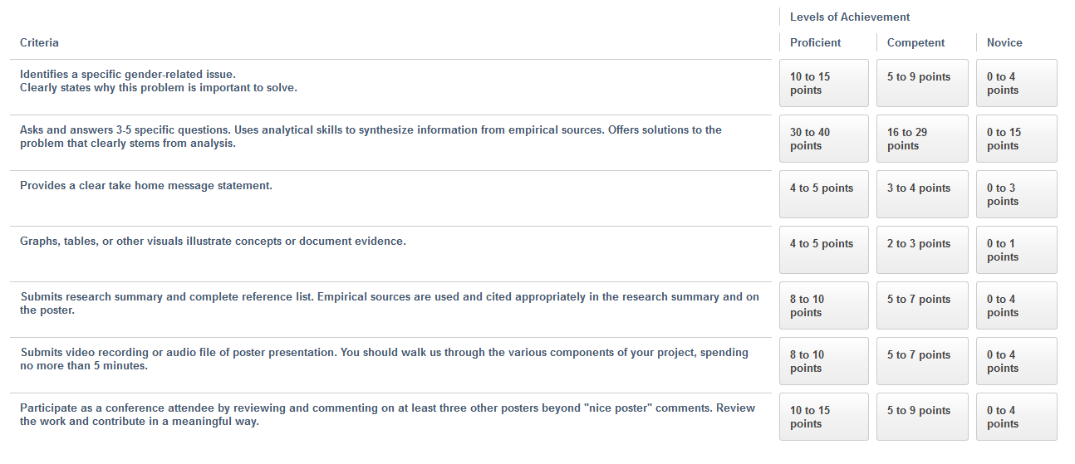
Final Project Rubric (100 points)

